Slide 1
The 2nd International Conference on Emerging Trends in Engineering (ICETE 2023)
Paper id- 9117
Title of the Paper-BCI based home automation system by using SSVEP Signals
Author 1 : D.Suman, Associate Professor, Osmania University
Author 2 : Pavani Thadem, Osmania University
Author 3 : Zurian Ketema, UNICEF, Jamaica, USA
Presenting Author – Pavani Thadem, Osmania University
1

Slide 2
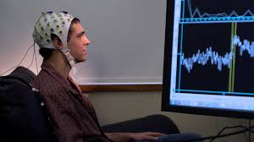


CONTENTS
Background
Introduction
Literature Review
Objectives
Methodology
Results And discussions
Conclusions & Future scope

Slide 3
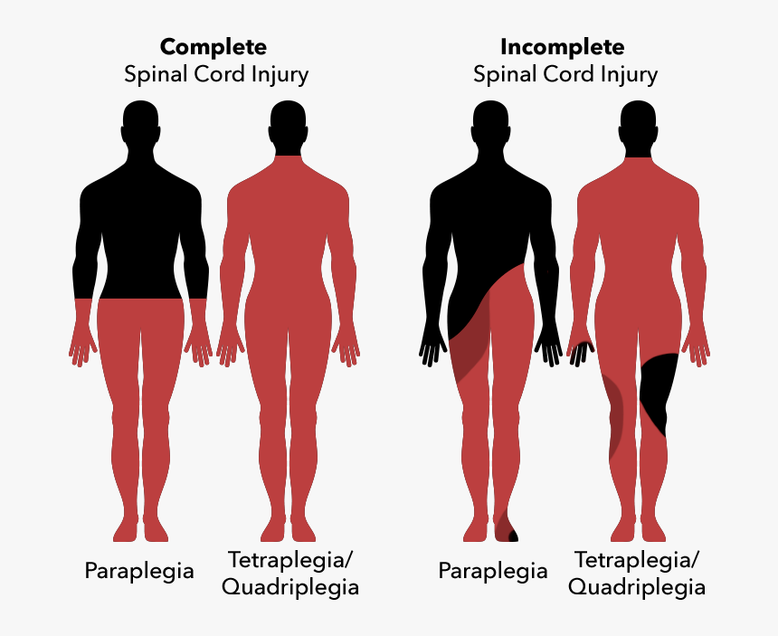
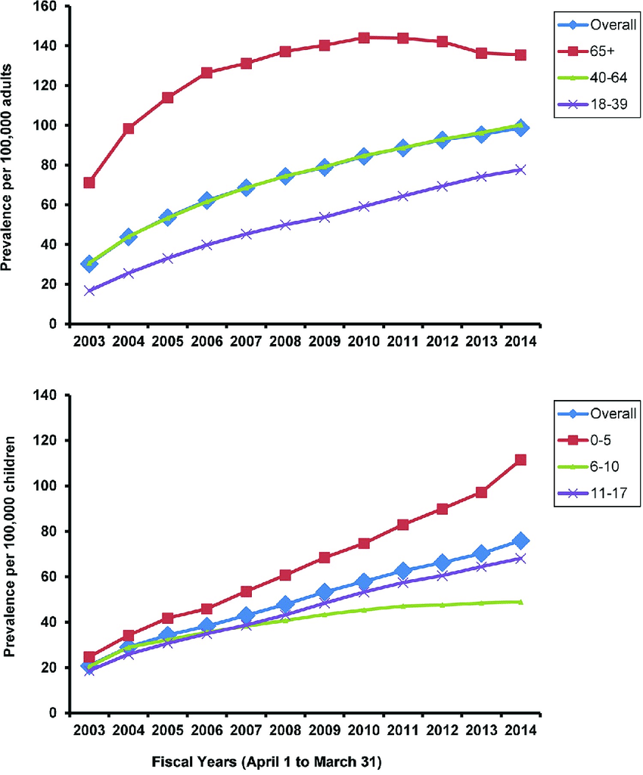
BACKGROUND
According to the survey conducted by WHO in 2019, 533,172 individuals suffered from the neurological disorders and lost their lives, among them 213,129 (40%) are men, and 320,043 (60%) are women.
About 1.9 percent of the population who are suffering from neuromuscular disorder roughly 1 among 500, approximately 35% of patients cannot control the domestic appliances.
Fig 1: spinal cord ingury
Fig 2: stastics on neuromuscular discorders

Slide 4

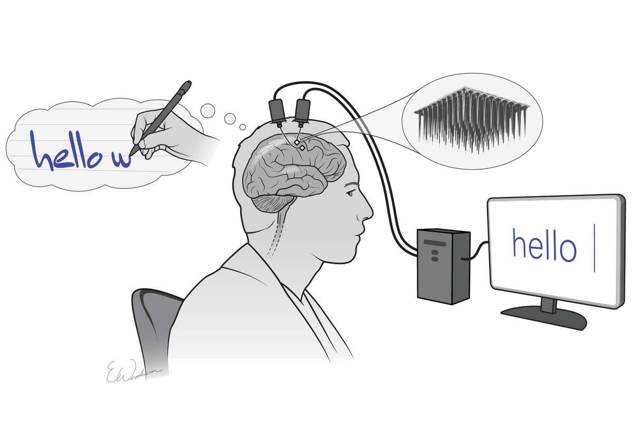
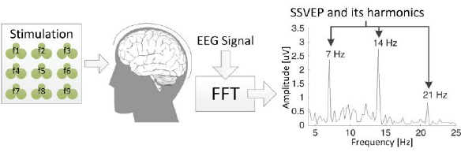
INTRODUCTION
Fig 3: Brain computer interface
Fig 4: Steady state visual evoked potential

Slide 5
LITERATURE REVIEW
Hui-Shyong Yeo etc all.
developed hand/finger (robust marker-less) tracking and gesture recognition system
Kaido Värbu etc all.
conducted a study on EEG-based BCI systems for medical purposes with the goal of aiding patients' return to a healthy life
ETU podder etc all
detected the event related desync/ sync of beta rhythms during hand imagery movements by PSA (Power Spectral Analysis)
Jeong et al.
Summary
They captured hand gesture using a single camera and transform the gesture variants into control commands by a circuit.
The motivation for this study is to contribute towards improving the life of tetraplegic patients.

Slide 6
OBJECTIVES
Objectives of the project is to
1) design and development of a portable visual stimulator
2) Perform Data collection
3) Implement Pre-processing and feature extraction of EEG signals
4) Detect SSVEP and control of home appliances

Slide 7
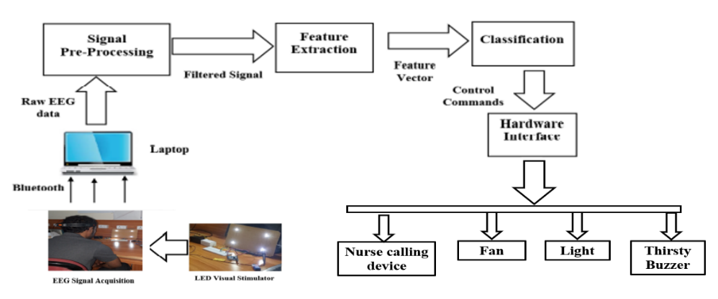
METHODOLOGY
Fig 5: Block diagram of SSVEP based BCI

Slide 8
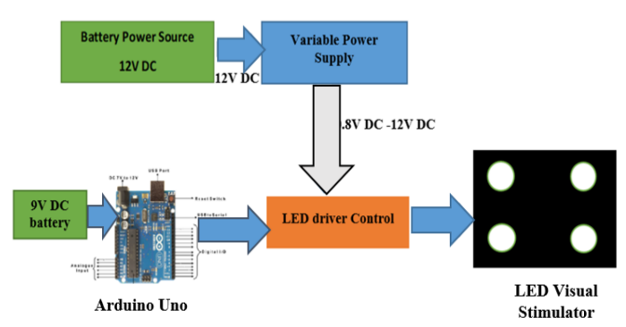
METHODOLOGY
Frequency in Hz | Time interval set (mSec)
7 | 70
8 | 61
9 | 54
10 | 49
Fig 6: Visual stimulus control block diagram
Table.1. generation of Flickering frequencies by timing

Slide 9
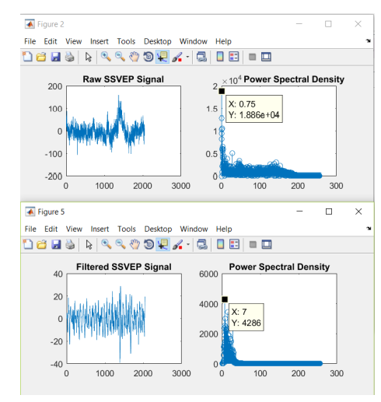
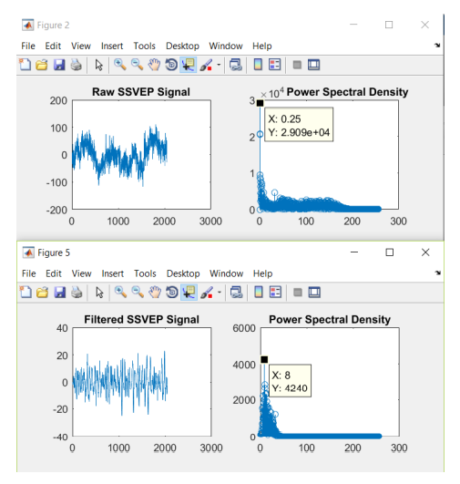
RESULTS AND DISCUSSIONS
Visual stimulus and flickering frequency analysis:
Fig 7: Yellow color LED flickering at 7 Hz
Fig 8: Green color LED flickering at 8 Hz

Slide 10
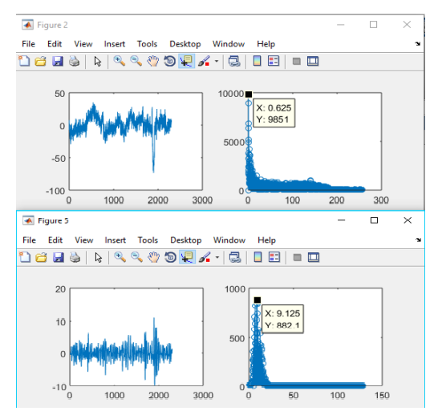
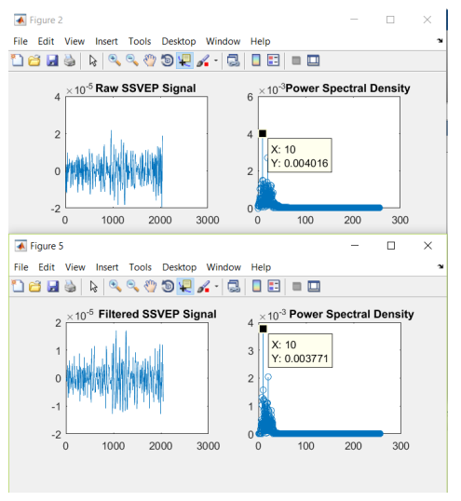
RESULTS AND DISCUSSIONS
Visual stimulus and flickering frequency analysis:
Fig 9: Blue color LED flickering at 9 Hz
Fig 10: White color LED flickering at 10 Hz

Slide 11
CONCLUSIONS & FUTURE SCOPE
A Portable Visual stimulator is developed for BCI based home automation by using four LEDs operated at four different flickering frequencies is designed and developed. Power spectrum analysis of EEG data is carried out to detect the elicited response of the brain to the flickering frequencies. It is found that the Maximum Power Frequency (MPF) is found to be statistically significant (p<0.001) in detection of the flickering frequency of the visual stimulus. This is immensely useful for Tetraplegia patients to operate the nurse emergency call devices and other accessories like fan, light and thirsty devices in the house.

Slide 12
ACKNOWLEDGEMENT
This work was supported by Telangana State Council of Science and Technology (TSCOST)-DST grant Lr.No.03/TSCOST/DST-PRG/2021-22. The authors wish to acknowledge the support received from SERB-DST-SCP for the grant SCP/2022/000933.

Slide 13
REFERENCES
[1] “Nurse Calling System | Welcome to Innovative Technologies , fire alarm panel, p a system,nurse calling system , power supply units.” [Online]. Available: http://innovatech.co.in/products/nurse-calling-system/.
[2] Q. P. Ha, T. H. Tran, and G. Dissanayake, “A wavelet- and neural network-based voice interface system for wheelchair control,” Int. J. Intell. Syst. Technol. Appl., vol. 1, no. 1/2, p. 49, 2005.
[3] H.-S. Yeo, B.-G. Lee, and H. Lim, “Hand tracking and gesture recognition system for human-computer interaction using low-cost hardware,” Multimed. Tools Appl., vol. 74, no. 8, pp. 2687–2715, Apr. 2015.
[4] S. Jeong, J. Jin, T. Song, K. Kwon, and J. Jeon, “Single-camera dedicated television control system using gesture drawing,” IEEE Trans. Consum. Electron., vol. 58, no. 4, pp. 1129–1137, Nov. 2012.
[5] Wenchang Zhang1,2 , Chuanqi Tan2, Fuchun Sun2, Hang Wu1, Bo Zhang2 2018. This article is published with open access at journals.sagepub.com/home/BSA
[6] Etu Podder, Md. Maniruzzaman, Alok Sarkar: 1st International Conference on Advances in Science, Engineering and Robotics Technology 2019 (ICASERT 2019) 978-1-7281-3445-1/19/©2019 IEEE.
[7] Sujata R. Kulkarni 1, Prakashgoud R. Patil2, Deepa Mulimani3 1KLE Technological University, Karnataka, Hubballi 2,3KLE Technological University, Karnataka, Hubballi : Survey on EEG based Brain Computer Interface for Emotion Detection
[8] Past, Present, and Future of EEG-Based BCI Applications: Kaido Värbu 1, Naveed Muhammad 1 and Yar Muhammad 2, https://doi.org/10.3390/s22093331

Slide 14
REFERENCES
[9] S. Amiri, A. Rabbi, L. Azinfar, and R. Fazel-Rezai, “A Review of P300, SSVEP, and Hybrid P300/SSVEP Brain- Computer Interface Systems,” 2013.
[10] J. D. R. Millán, R. Rupp, G. R. Müller-Putz, R. Murray-Smith, C. Giugliemma, M. Tangermann, C. Vidaurre, F. Cincotti, A. Kübler, R. Leeb, C. Neuper, K.-R. Müller, and D. Mattia, “Combining Brain-Computer Interfaces and Assistive Technologies: State-of-the-Art and Challenges.,” Front. Neurosci., vol. 4, 2010.
[11] Y. Liu, X. Jiang, T. Cao, F. Wan, P. U. Mak, P.-I. Mak, and M. I. Vai, “Implementation of SSVEP based BCI with Emotiv EPOC,” in 2012 IEEE International Conference on Virtual Environments Human-Computer Interfaces and Measurement Systems (VECIMS) Proceedings, 2012, pp. 34–37.
[12] R. J. Huster, S. Debener, T. Eichele, and C. S. Herrmann, “Methods for simultaneous EEG-fMRI: an introductory review.,” J. Neurosci., vol. 32, no. 18, pp. 6053–60, May 2012.
[13] J. L. Semmlow and B. Griffel, “Digital Filters” in BIOSIGNAL and MEDICAL IMAGE PROCESSING, 3rd ed. CRC Press, 2014. 16
[14] G. R. Muller-Putz and G. Pfurtscheller, “Control of an Electrical Prosthesis With an SSVEP-Based BCI,” IEEE Trans. Biomed. Eng., vol. 55, no. 1, pp. 361– 364, Jan. 2008.
[15] C. Guger, B. Z. Allison, B. Großwindhager, R. Prückl, C. Hintermüller, C. Kapeller, M. Bruckner, G. Krausz, and G. Edlinger, “How Many People Could Use an SSVEP BCI?,” Front. Neurosci., vol. 6, p. 169, Nov. 2012

Slide 15
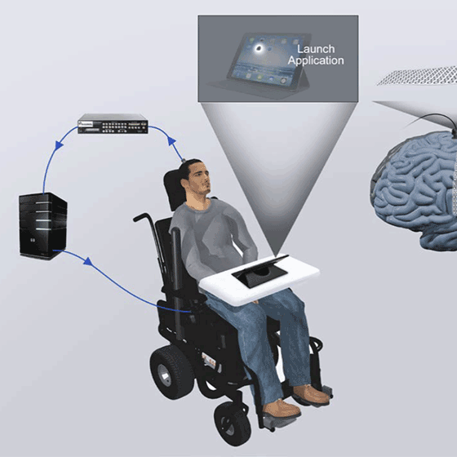
Thank You
Presenter name: Pavani Thadem

